Slide 1
Thermodynamics and Energy Systems Labs
Health and Safety Instructions
(B135B and A305)

Slide 2
Outline
General Health and Safety
Lab and Equipment Specific Safety
  Steam Turbine Lab (Steam cycle)
  Diesel and Petrol Engine Labs (Gas power cycle)
  Geothermal Refrigeration and Heat Pump (Vapor compression cycle)
  Air Engine Thermodynamic Cycle (Gas power cycle)
  Heat Exchanger Equipment (Conduction, Convection/Radiation, Shell and Tube Heat Exchange)
  Bomb Calorimeter (Heating Value of Fuels)

Slide 3
General Health and Safety

Slide 4
Work Attitude
Always think and act safely: - Identify precautions for – yourself – others – equipment & machines
Review safety instructions included in equipment manuals and/or handouts before doing any lab activity
Know first aid
Try to minimize strain and stress
Concentrate, don’t be distracted (stop if necessary)
Don’t become complacent
Treat and report injuries (fill out forms / document). Even minor injuries can develop into more serious ones.
Use as natural a position as possible when working

Slide 5
Lab Clothing / P.P.E.
Safety glasses with side shields protect from chips or broken tooling
No open toed shoes, thick soles, heavy uppers, should be worn to protect from (falling objects, razor sharp cuttings)
Goggles or face shields are required for certain operations
“NO” Loose clothing, if wearing a long sleeved shirt, button the cuffs or roll up the sleeves
Ties shouldn’t be worn in the shop, they can be pulled into machinery
Aprons should be tied in the back
Generally gloves should “NOT” be worn as they can get caught and pulled into moving machinery
Gloves may be worn when handling sharp or hot material
Long hair should be confined with a hair net, tied back or under a cap (drill presses are notorious for catching long hair and pulling in workers)

Slide 6
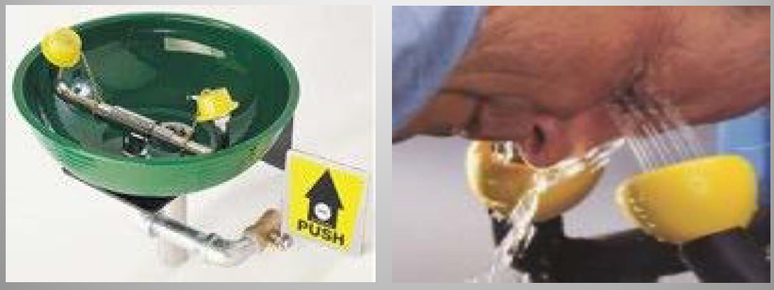
Eye Wash Stations
All our labs have Eye Wash Stations
In the event of chemicals being splashed into the eyes:
  flood the eyes with water (eye wash station)
  forcibly hold eyes open if necessary
  wash/flood for a minimum of fifteen minutes

Slide 7
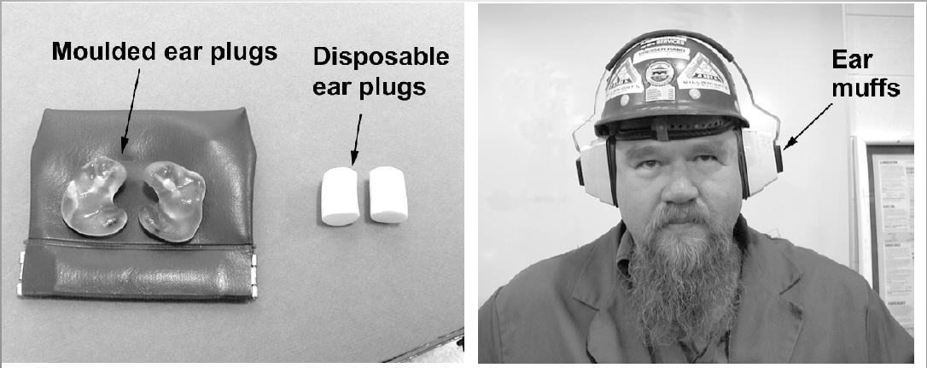
Hearing Protection
Some of our labs (e.g., small engine test bed) produce noise levels that require you to ensure hearing protection.
Hearing protection (plugs or muffs) should be worn as required

Slide 8
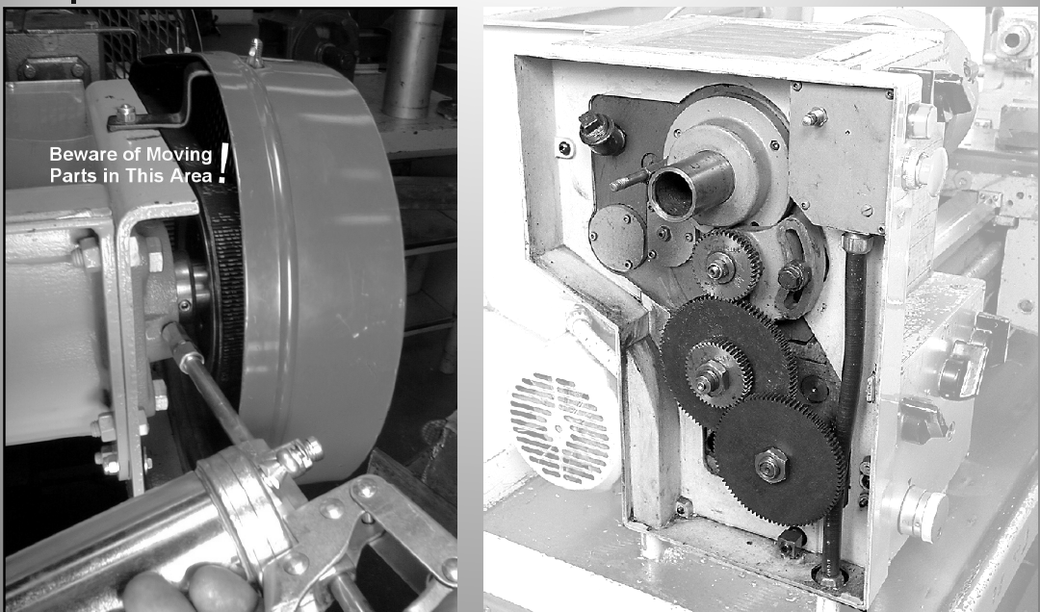
Machine Guards
Guards are designed to cover moving parts and must be in place. Some of the equipment used in our labs (primarily power transmission equipment and components) have guards.
  Note that our small engine test bed, includes guards.
Under no circumstances remove these guards.

Slide 9
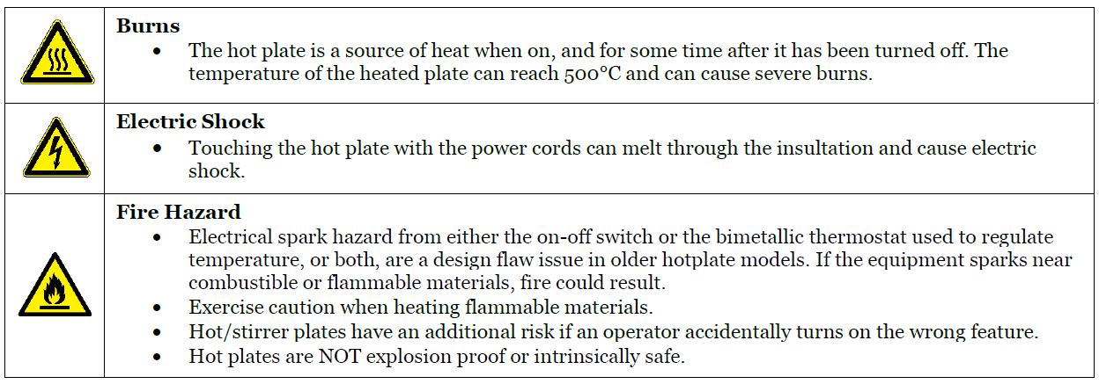
Hot Plate Safety
A number of labs in physics and energy related areas use hot plates to heat water for various experiments. Carefully follow labs instructions and hand out for each lab to avoid injuries

Slide 10
Electrical General Safety
Read and follow all equipment operating instructions for proper use. Ask yourself, "Do I have the skills, knowledge, tools, and experience to do this work safely?" → Avoid activities that require training beyond what’s provided in your lab manual and handouts.
Inspect all electrical and extension cords for wear and tear. Pay particular attention near the plug and where the cord connects to the piece of equipment. If you discover a frayed electrical cord, contact your lab instructor or technician for assistance.
Keep work areas clean and dry. Cluttered work areas and benches invite accidents and injuries.

Slide 11
Chemical General Safety
Know locations of laboratory safety showers, eyewash stations, and fire extinguishers.
Know emergency exit routes.
Avoid skin and eye contact with all chemicals.
Minimize all chemical exposures.
Assume that all chemicals of unknown toxicity are highly toxic.
Avoid distracting or startling persons working in the laboratory.
Use equipment only for its designated purpose.
Combine reagents in their appropriate order, such as adding acid to water.
All laboratory personnel should place emphasis on safety and chemical hygiene at all times.
Never leave containers of chemicals open.
All containers must have appropriate labels. Unlabeled chemicals should never be used.
Do not taste or intentionally sniff chemicals.
Never consume and/or store food or beverages where hazardous chemicals are used or stored.
Do not use mouth suction for pipetting or starting a siphon.
Wash exposed areas of the skin prior to leaving the laboratory.
No contact lenses should be worn around hazardous chemicals – even when wearing safety glasses.
Determine the potential hazards and appropriate safety precautions before beginning any work.
Do not pour chemicals down drains. Do NOT utilize the sewer for chemical waste disposal.

Slide 12
Lab and Equipment Specific Safety Instructions

Slide 13
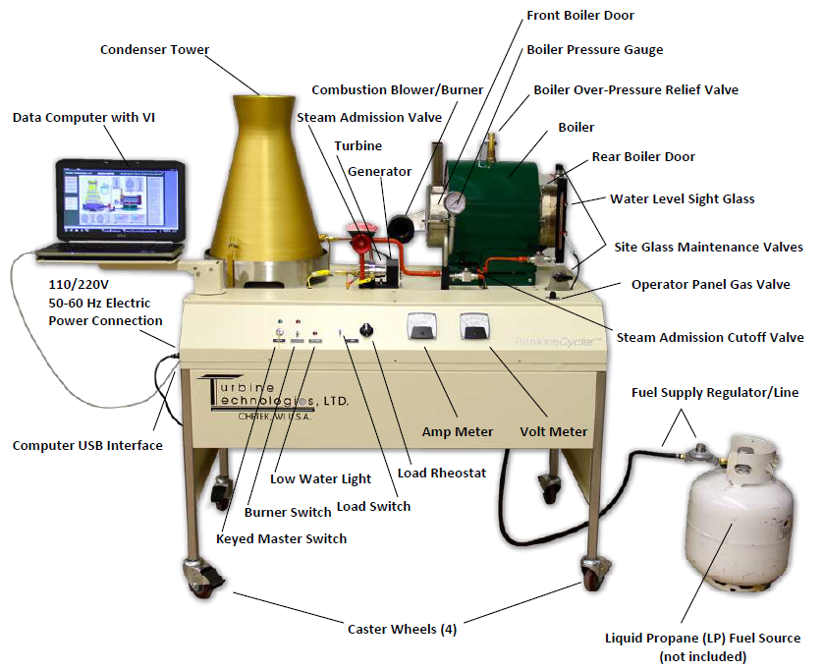

Steam Turbine
In this lab, steam is generated by heating water in a multi-pass, flame-through tube type boiler with a super heat dome. This high-pressure steam is expanded through an axial flow turbine that drives an AC/DC generator to produce electricity
All steps must be carefully followed based on the lab handout and instructions
FAILURE TO FOLLOW THE LIMITATIONS AND USAGE AS SET FORTH IN THE OPERATOR'S MANUAL (PROVIDED WITH YOUR HANDOUT) MAY CAUSE SERIOUS INJURY OR DEATH.

Slide 14
Safety Instructions Under ABNORMAL conditions
Abnormal Condition 1: BOILER OVERPRESSURE
The unit has three independent mechanisms and redundancies to avoid such abnormal conditions. However, under such abnormal conditions, the following steps must be taken:
The console MASTER SWITCH should be placed in the OFF position.
The STEAM ADMISSION VALVE should be turned counter-clockwise to the fully OPEN position.
Turn the OPERATOR PANEL GAS VALVE (or FUEL SOURCE) to the OFF position.
IF SAFETY IS NOT COMPROMISED in any way, the following additional steps should be considered:
  a. Select the LOAD SWITCH to the ON position.
  b. Rotate the LOAD RHEOSTAT CONTROL to the FULLY CLOCKWISE position.

Slide 15
Safety Instructions Under ABNORMAL conditions
Abnormal Condition 2: FIRE
The unit has an extremely low chance of causing fire. However, under such abnormal conditions, the following steps must be taken:
The console MASTER SWITCH should be placed in the OFF position.
Using an available and appropriate FIRE EXTINGUISHER (ABC Type), extinguish the flames.
If operator safety is in question, all personnel should leave the area, activate the appropriate fire alarm and follow the required emergency plan.
IF SAFETY IS NOT COMPROMISED in any way, the following additional steps should be considered:
  a. The STEAM ADMISSION VALVE should be turned counter-clockwise to the
  fully OPEN position.
  b. Turn the OPERATOR PANEL GAS VALVE (or FUEL SOURCE) to the OFF position.

Slide 16
Safety Instructions Under ABNORMAL conditions
Abnormal Condition 3: ELECTRICAL
There are two distinct electrical systems within the unit; the main bus that powers the indicator lights, boiler combustion blower and the gas regulator system and a separate steam generator bus allowing the measurement of electrical generating capability of the steam turbine. Any electrical malfunction of a short or overload nature will trip the on-board circuit breaker, the facility circuit breaker or both. If an electrical fault is suspected, either through an unexpected shut-down of the unit or through more obvious signs such as audible or visible arcing or electrical type smoke caused by melting insulation, the following steps should be followed:
The console MASTER SWITCH should be placed in the OFF position.
The STEAM ADMISSION VALVE should be turned counter-clockwise to the fully OPEN position.
Turn the OPERATOR PANEL GAS VALVE (or FUEL SOURCE) to the OFF position.
The LOAD SWITCH should now be selected OFF

Slide 17
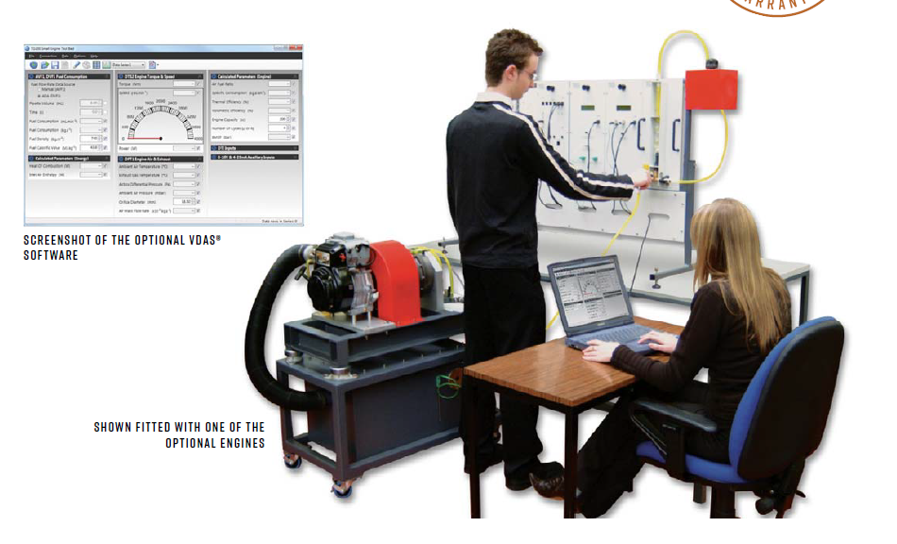
Small Engine – Diesel and Gasoline Modules

Slide 18
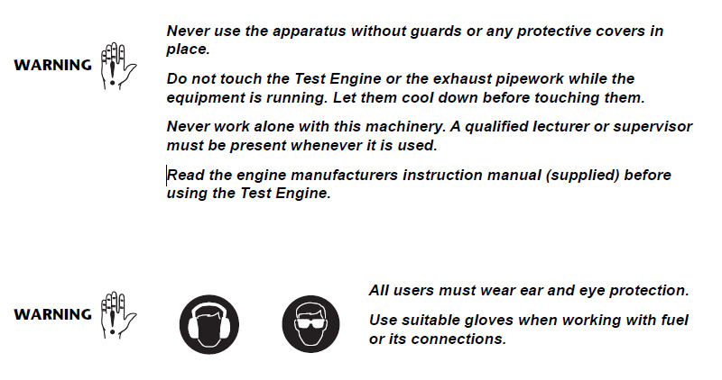
Small Engine Basic Safety

Slide 19
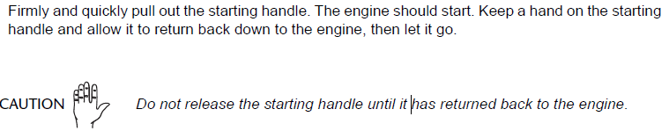
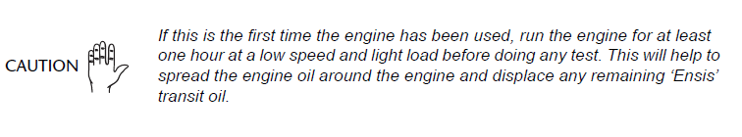
Engine Start Safety
This is a manual recoil engine. Make sure the switch is on before pulling the starting handle.

Slide 20
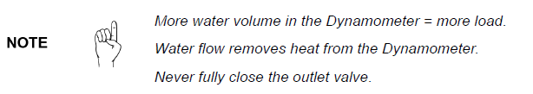

Engine Operation
Torque and speed measurements in this apparatus are done using a dynamometer (or "dyno" for short), which is a device for simultaneously measuring the torque and rotational speed (RPM) of an engine. See experiment handout for location of water valves connecting to the dynamometer.

Slide 21
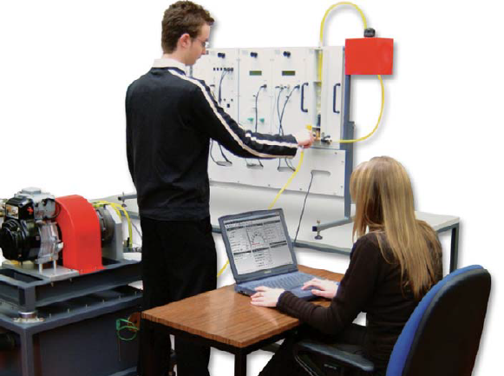

Instrument Frame
Test bed and the instrument frame are kept separately to avoid damage to the instrument frame due to vibration.
Instrument frame includes fuel measurement levels and fuel tank, and fuel lines.

Slide 22
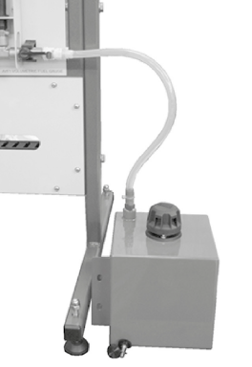

Fuel Tank Safety
Under no circumstances student must attempt refueling the tank.
Fuel Tank has a drain valve. Under no circumstances student are allowed to open this valve during or after the experiment.
Fuel unused in the fuel line must be redrained back into the fuel tank at the end of experiments.

Slide 23
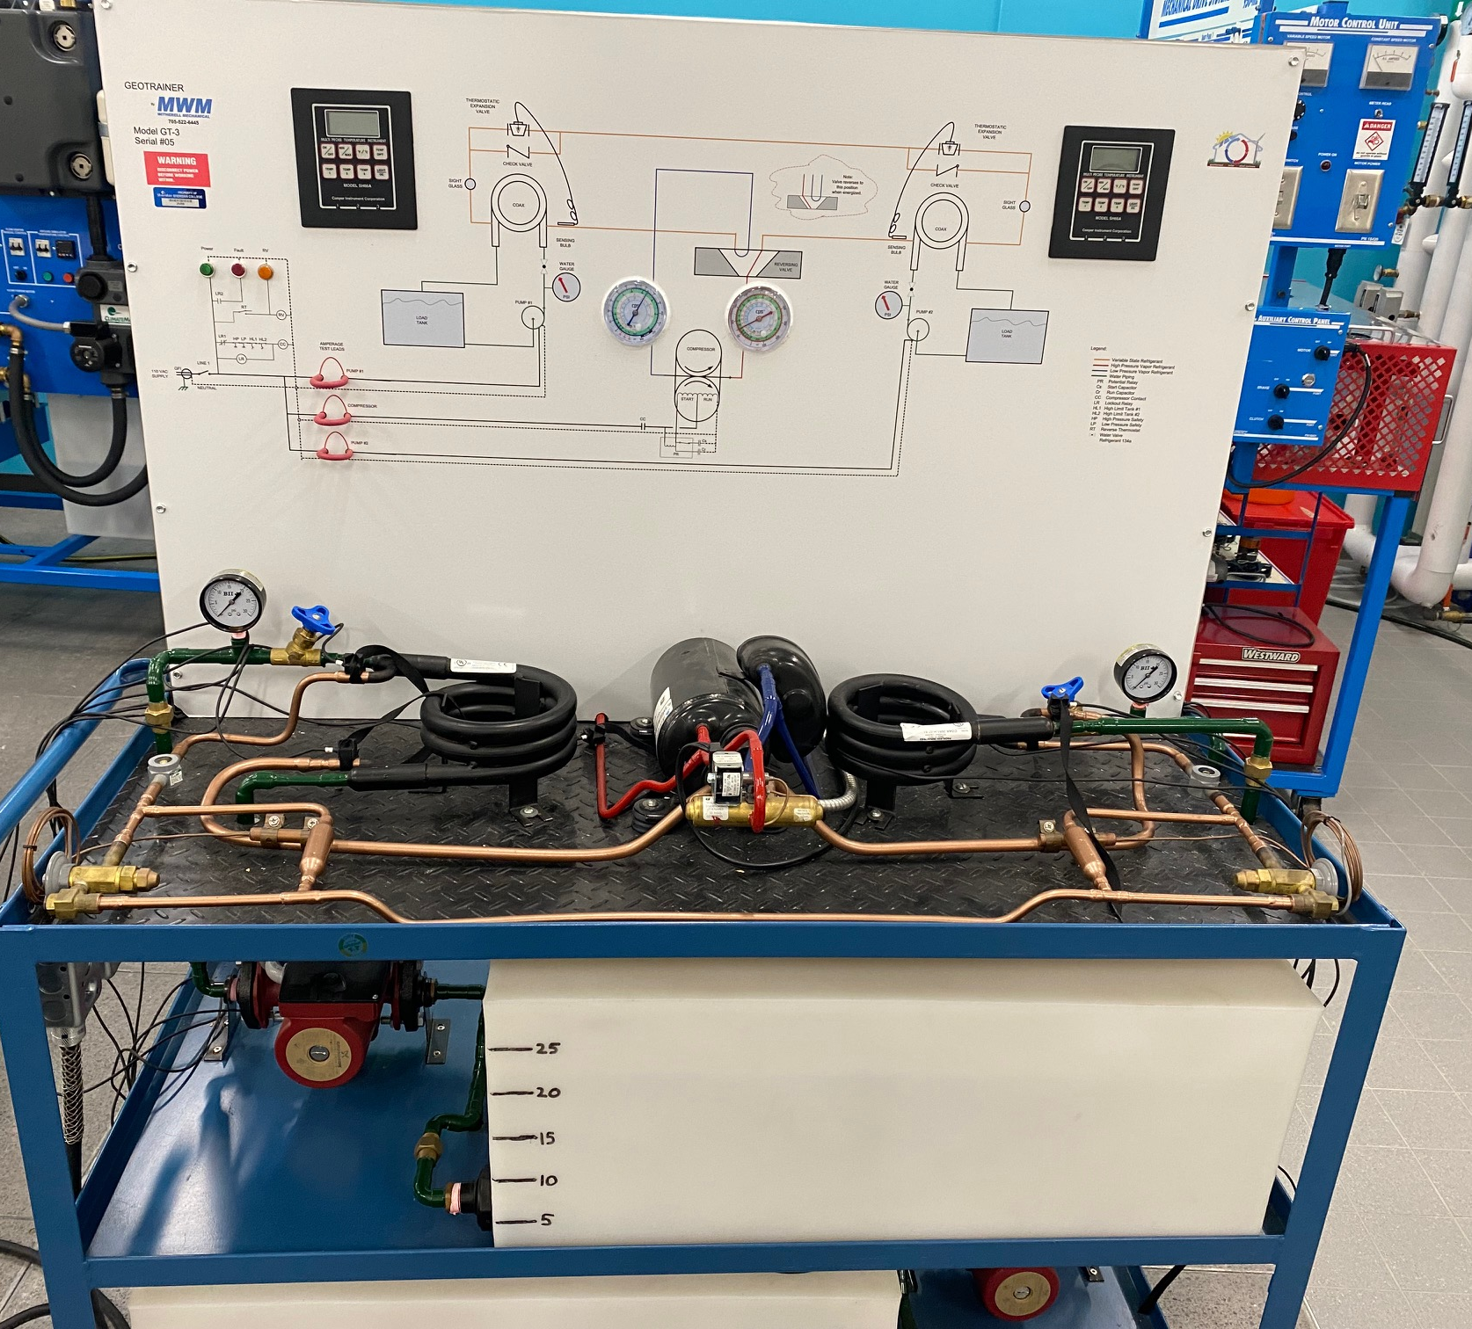
Geothermal Heap Pump
The mobile platform, house two energy storage (water) tanks with 3 speed circulating pumps to vary and measure water flow rates.
Two Co-axial refrigerant heat exchangers with metering devices and a refrigerant reversing valve, direct the compressor's electrical mechanical energy to sensible and latent heat energy, through visible and tactile heat transfer and phase change.

Slide 24
Geothermal Safety Considerations
Temperature, pressure and electrical monitoring equipment are provided to calculate what the student is observing, and complete the learning experience. Electrical, water and refrigerant circuits are color coded for intuitive instruction. Water, drain and a 120 VAC grounded receptacle is all that is required to teach today's conventional heat pump technology.
Basic health and safety, including electrical safety consideration apply in this lab. You will be required to measure temperature, using clip-on temperature sensors, and current, using current clamp meter.
If you suspect that there is any leak in the system, or notice a rapid pressure change in the compressor, turn off the system and inform your instructor or lab technician

Slide 25
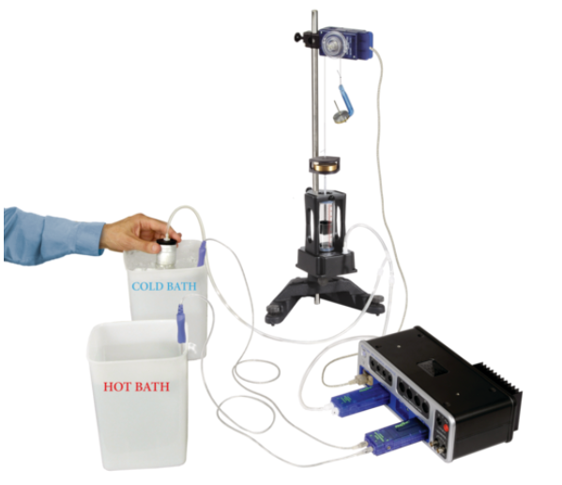
PASCO Air Heat Engine
Thermodynamic cycles involving air compression, expansion in cold and hot baths is investigated using this apparatus.
Basic as well as Hot plate health and safety instructions apply

Slide 26
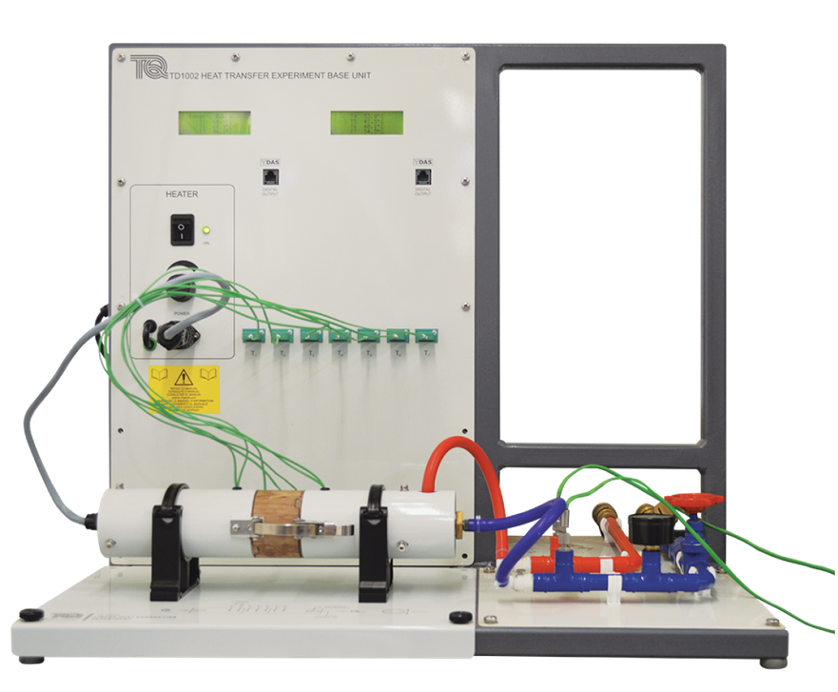
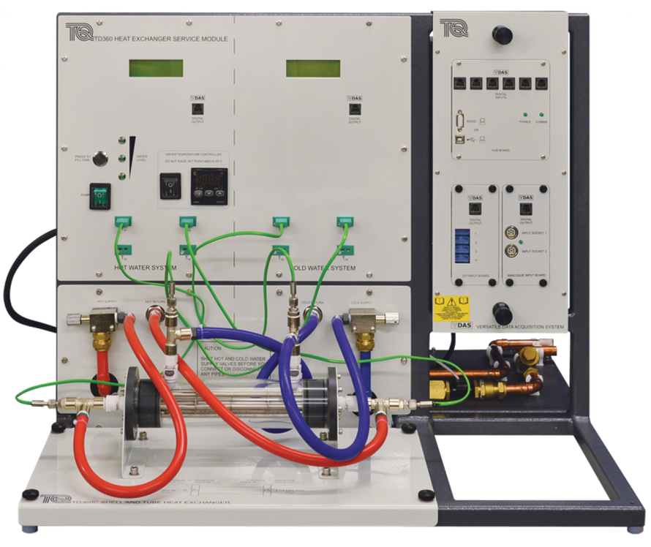
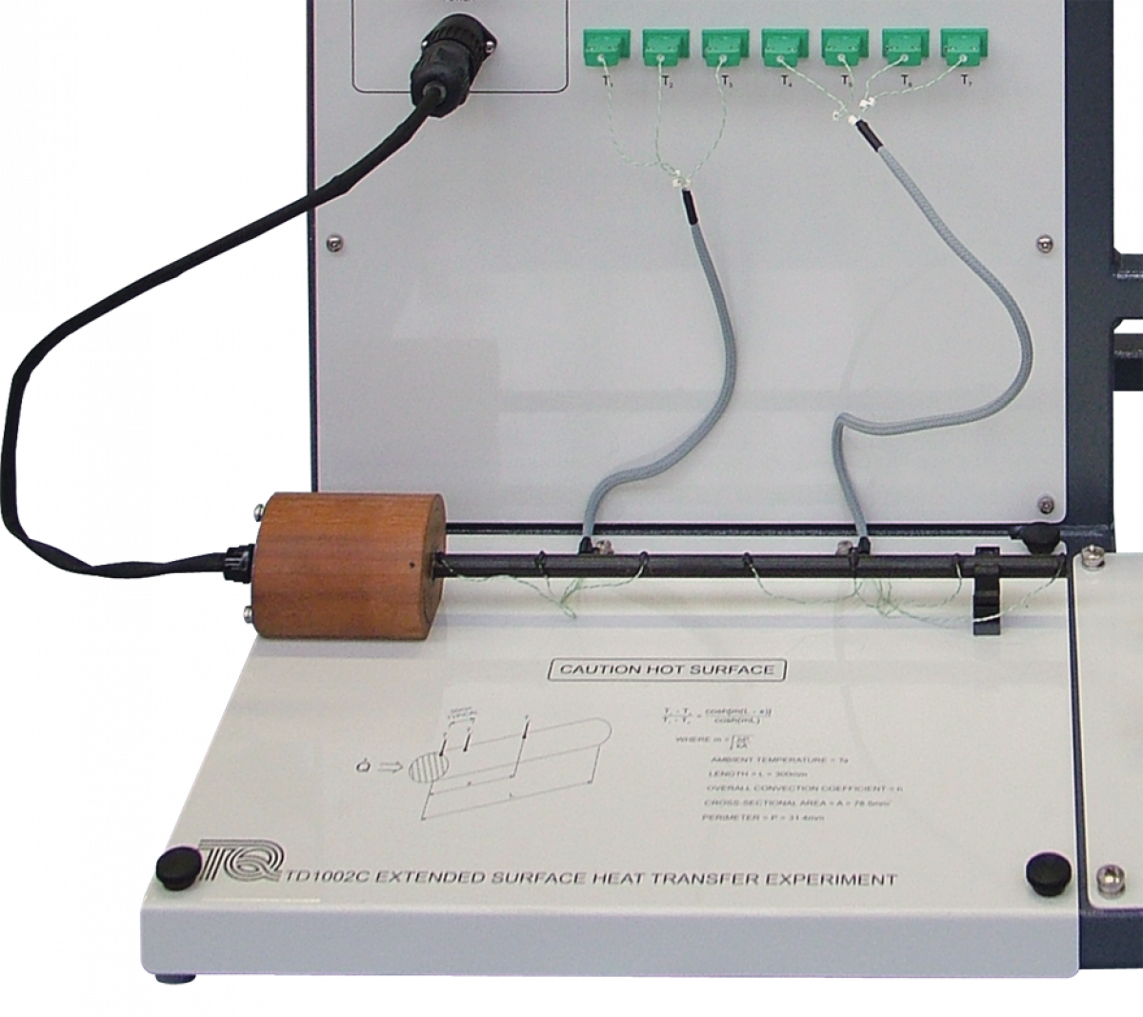
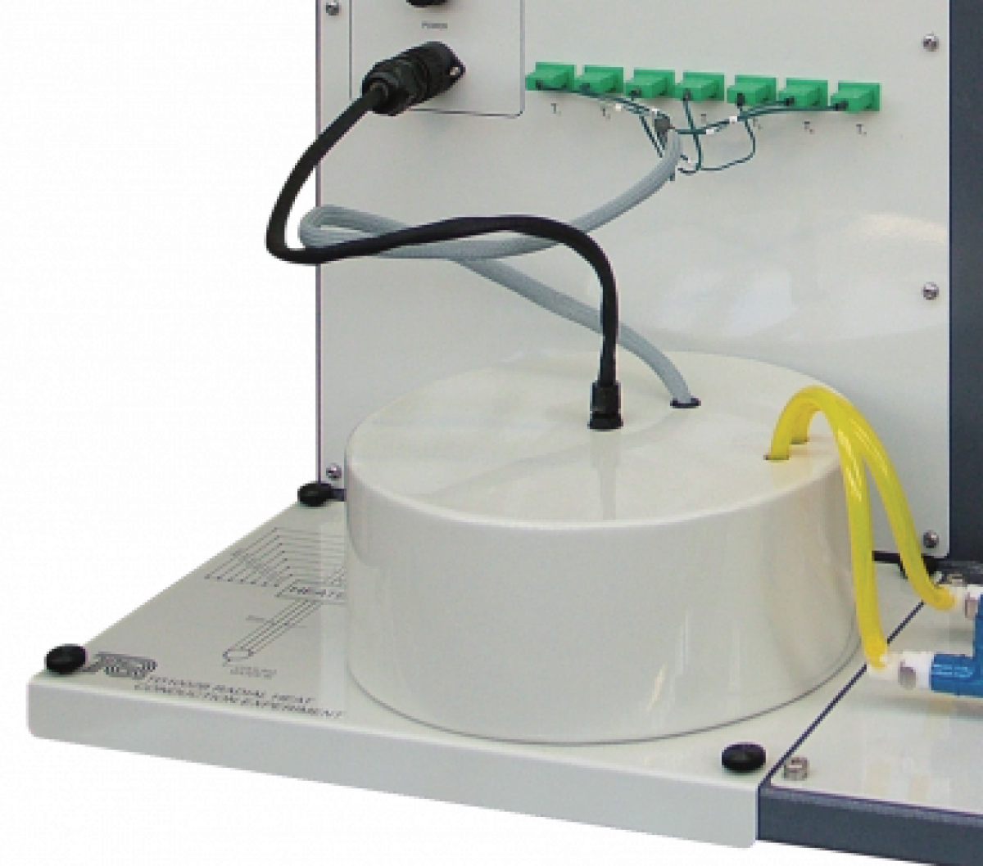
Heat Transfer Equipment
Heat Conduction (linear and radial) and Extended Surface Convection and Radiation
Shell and Tube Heat Exchanger

Slide 27
Heat Transfer Equipment Safety
Follow general health and safety instructions for heat transfer labs.
Water is the usually the coolant for these labs. Always clean up any water spills Immediately. Never use any electrical twitches when you have wet hands.
Thermal conduction experiments may require you to use a thermal paste. Although the paste is non-toxic and harmless, it does not wash easily. Wear disposable gloves to apply thermal paste on samples.
Various labs require various power setting for the electrical heaters in the unit. Never exceed the MAXIMUM ALLOWABLE power identified for each lab. For instance:
  For the extended surface convection/radiation, do not exceed 10 W power, or the temperature of the bar at the first thermocouple will become greater than 100 °C.

Slide 28
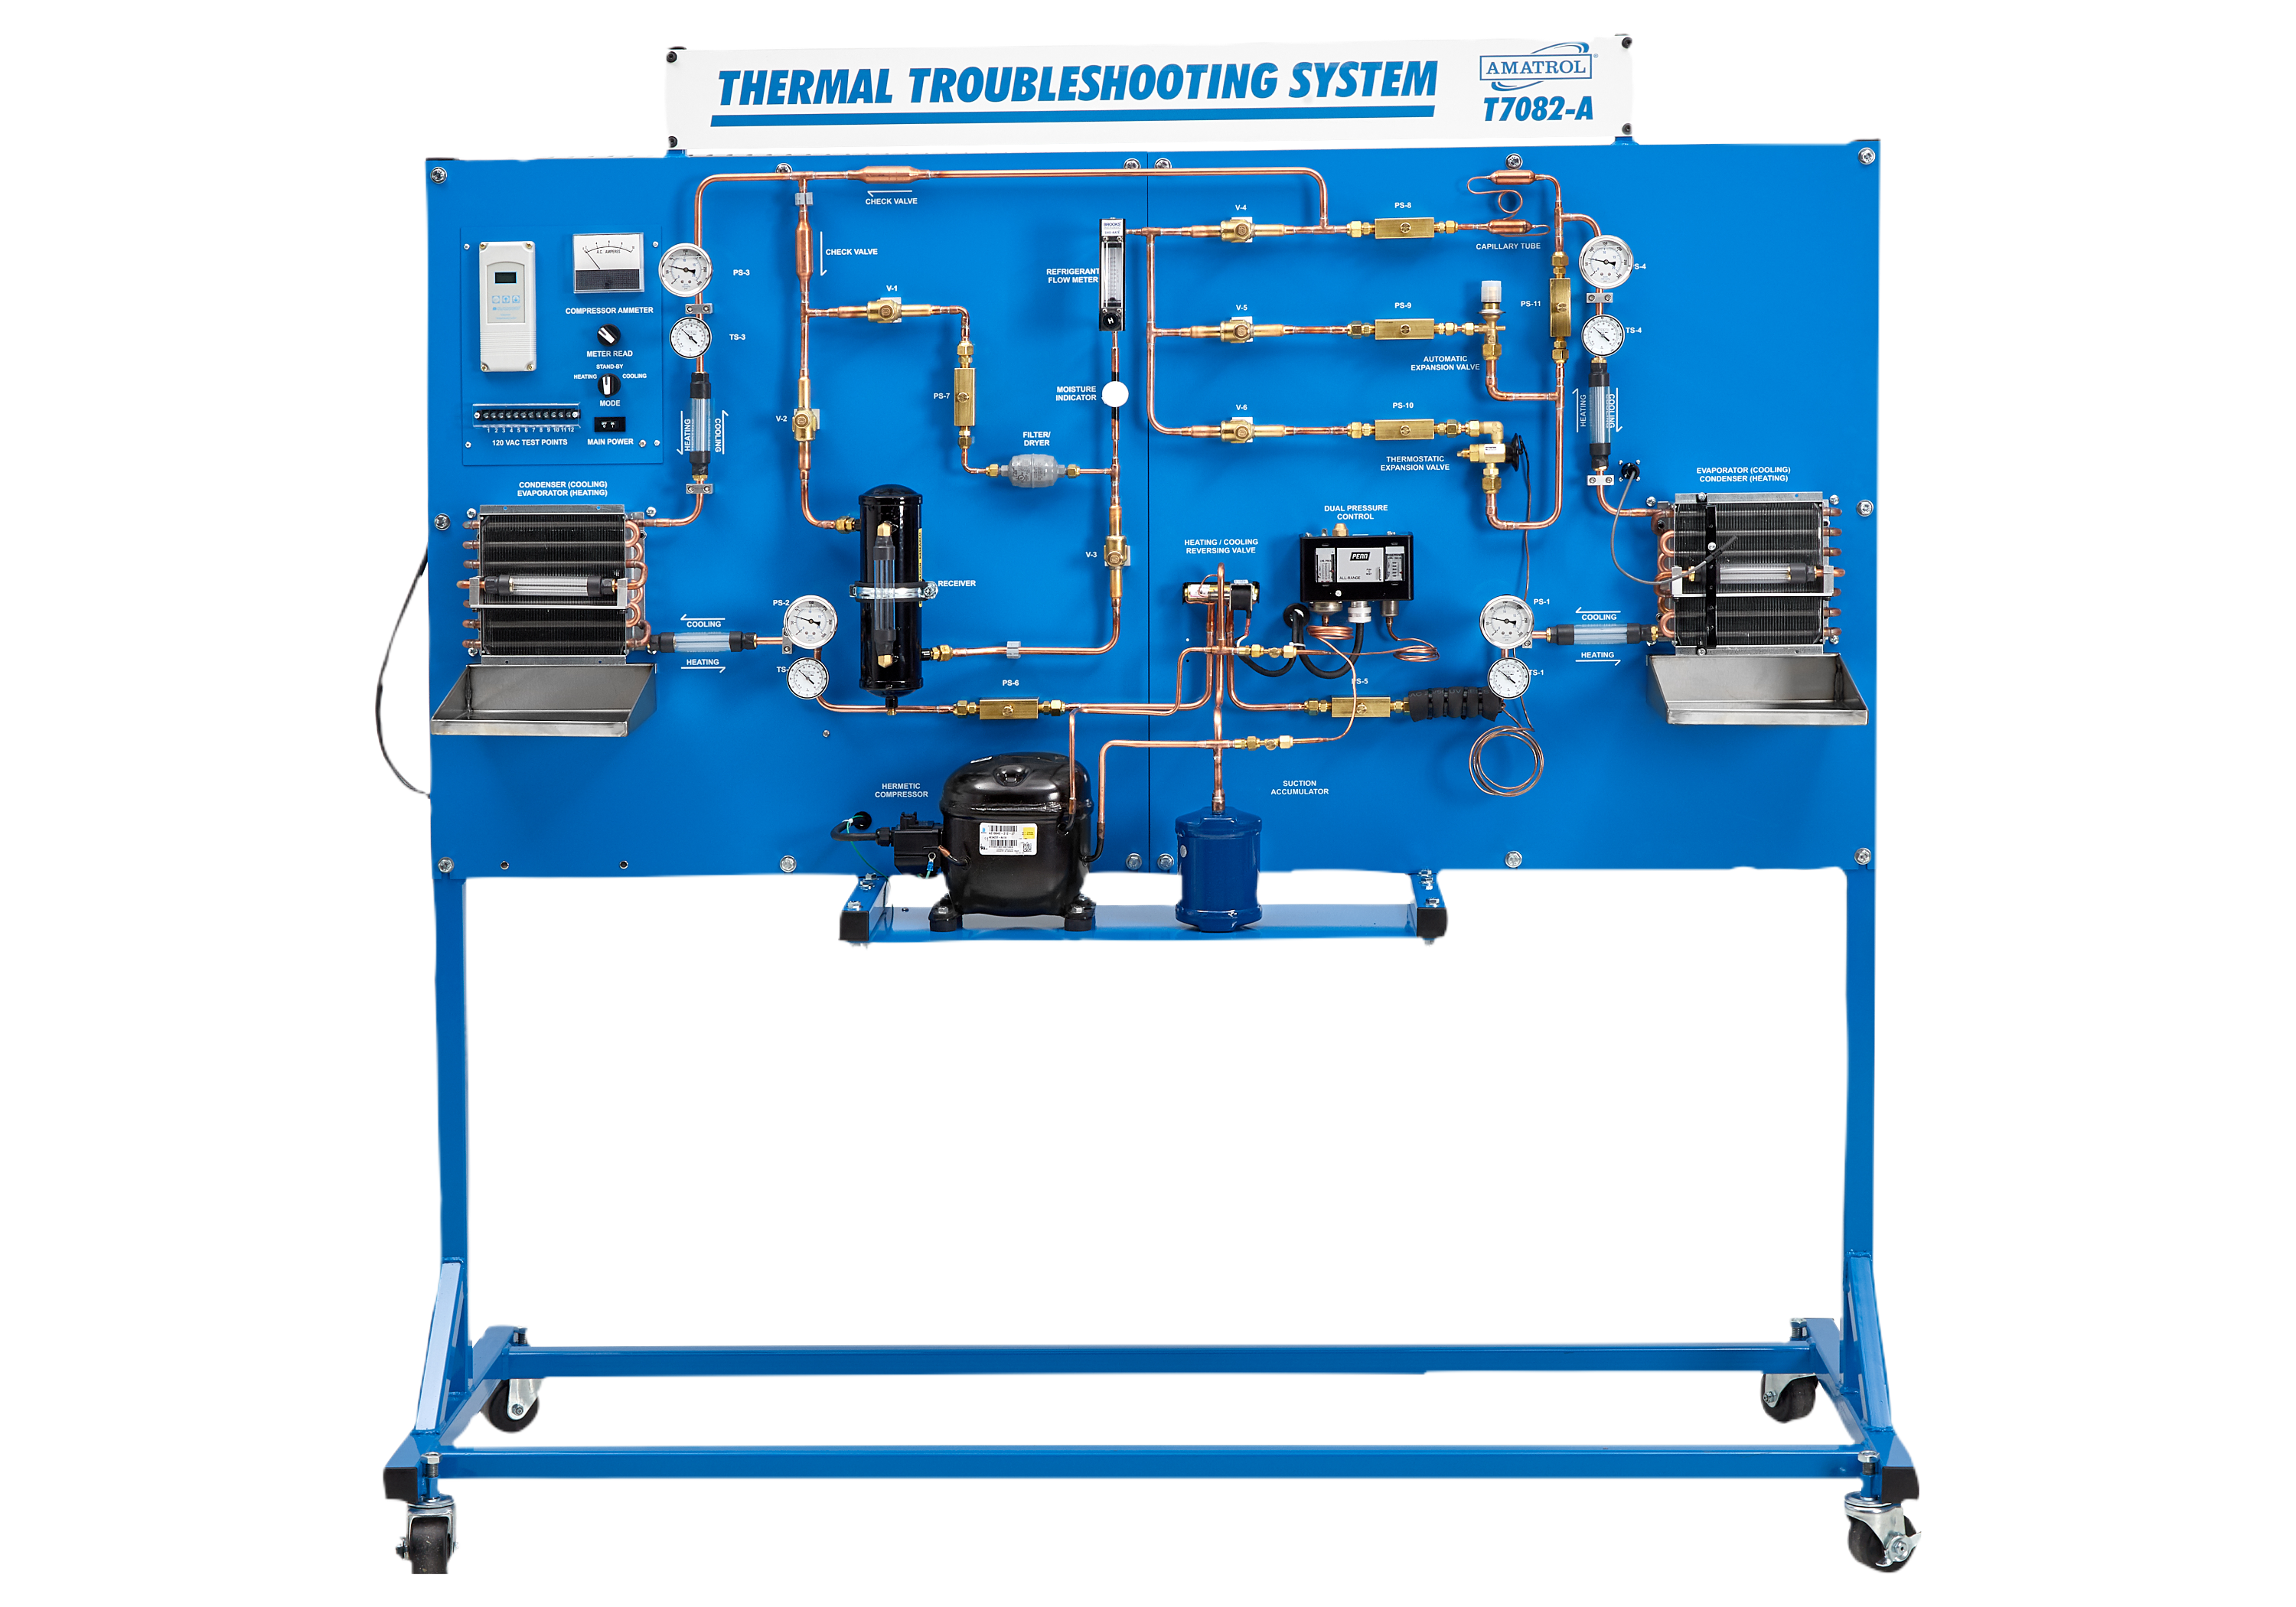
Refrigeration Cycle
Follow general health and safety instructions for refrigeration cycle related labs. All steps must be per student handouts and manuals.
Various labs requires change in valve settings to test various refrigeration cycle concepts and throttling devices. Do not change valve setting (ON/OFF) while the unit is operating.

Slide 29
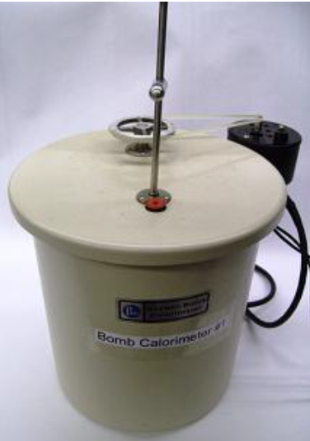
Bomb Calorimeter
Apparatus to measure heating value of fuels
Includes a pressure vessel filled with Oxygen at 20 bar
CAREFULLY follow all steps based on lab instructions.

Slide 30
Bomb Calorimeter Safety
Do not use too much sample. The total charge placed in the bomb must not liberate more than 8000 calories when burned in oxygen at an initial pressure of 35 atmospheres. This usually limits the Samples weight to not more than 1.1 grams. Use a small fraction of the maximum allowable sample weight when testing unfamiliar materials which may burn either rapidly or explosively.
Do not fill the bomb with more oxygen than is necessary to obtain complete combustion (25 bar based on your lab handout). Under no circumstance fire the bomb if it is pressurized to more than 35 atmospheres.
Keep all parts of the bomb, especially the valves and insulated electrode, in good repair at all times. If gas bubbles escape from the bomb when it is submerged in water, do not fire the charge.
Keep away from the top of the calorimeter for 30 seconds after firing. If the bomb should rupture, it is most likely that the resultant forces will be directed along the vertical axis.
Never use lubricants on valves or fittings in contact with high pressure oxygen.

